Slide 1
Why do employees like to be paid with Options? A multi-period prospect theory approach
Lei Sun, Martin Widdicks
Journal of Corporate Finance 2016

Slide 2
Prospect theory
主流經濟學都假設每個人作決定時都是「理性決策」，會選擇 效用較高的結果，然而現實情況並不如此。
展望理論加入了人們對賺賠、與發生機率高低等條件的不對稱 心理效用，成功解釋了許多看來不理性的現象。

Slide 3
Certainty effect (for high probability outcome)
Expected return method
 | A | B
Gain | 95% to win $10,000 | 100% to win $9,499
Loss | 95% to loss $10,000 | 100% to loss $9,499
Gain → risk averse
Loss → risk loving

Slide 4
Possibility effect (for low probability outcome)
Expected return method
 | A | B
Gain | 5% to win $10,000 | 100% to win $501
Loss | 5% to loss $10,000 | 100% to loss $501
Gain → risk loving
Loss → risk averse

Slide 5
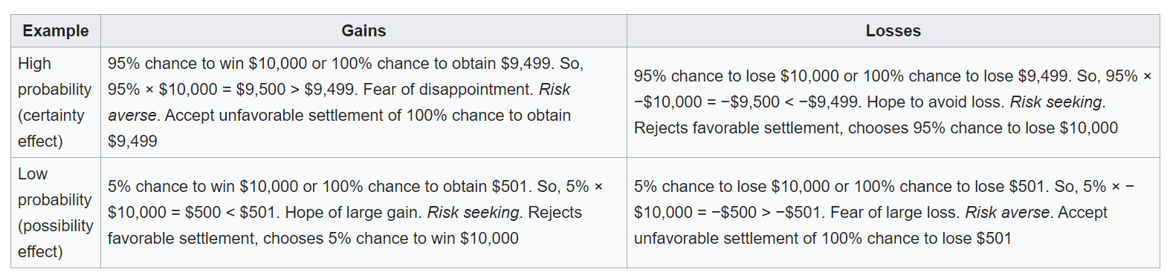

Slide 6
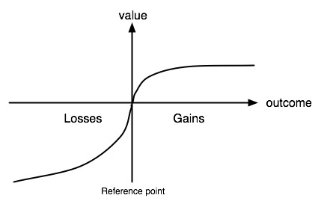
Utility function
Loss averse
(same amount of money but differ in utility)

Slide 7
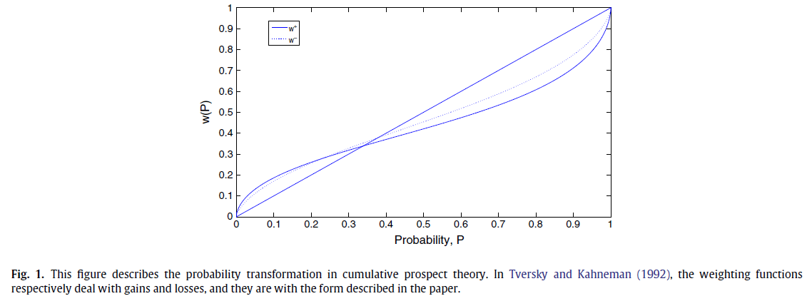
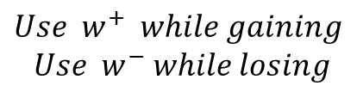
Probability weighting
用來解釋人們傾向高估「機率小事件」、低估「機率大事件」(機率)
Certainty effect
Possibility effect
$$Use w^{+} while gaining$$
$$Use{ w}^{−} while losing$$

Slide 8
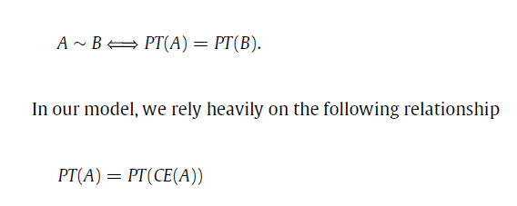

Prospect theory
Combining new Utility function & Probability weighting
We consider cumulative prospect : $PT\left(x,p\right)=$ $\sum{\left(w\left(p\right)∗U(x)\right)}$

Slide 9
Why do employees like to be paid with Options? A multi-period prospect theory approach
Lei Sun, Martin Widdicks
Journal of Corporate Finance 2016

Slide 10


Model
See ESO as at-the-money American call for 10 years maturity
(without vesting period)
Company stock price at time t follows geometric Brownian motion :
$$z is standard normal distribution$$

Slide 11

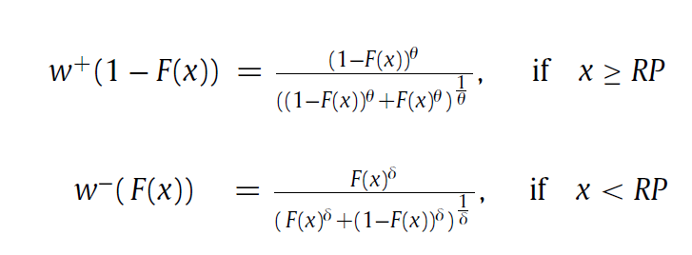
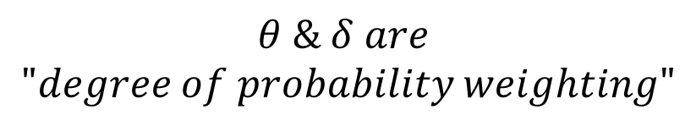




Utility function :
Probability weighting :
$$x :possible payoff$$
$$RP is the reference point (in this paper will have 3 RP)$$
$$α∈\left(0,1\right) is loss aversion coefficient$$
$$λ≥1 is loss punishment coefficient$$
$$F\left(x\right) is c.d.f. of x$$
$$θ \& δ are$$
$$"degree of probability weighting"$$

Slide 13
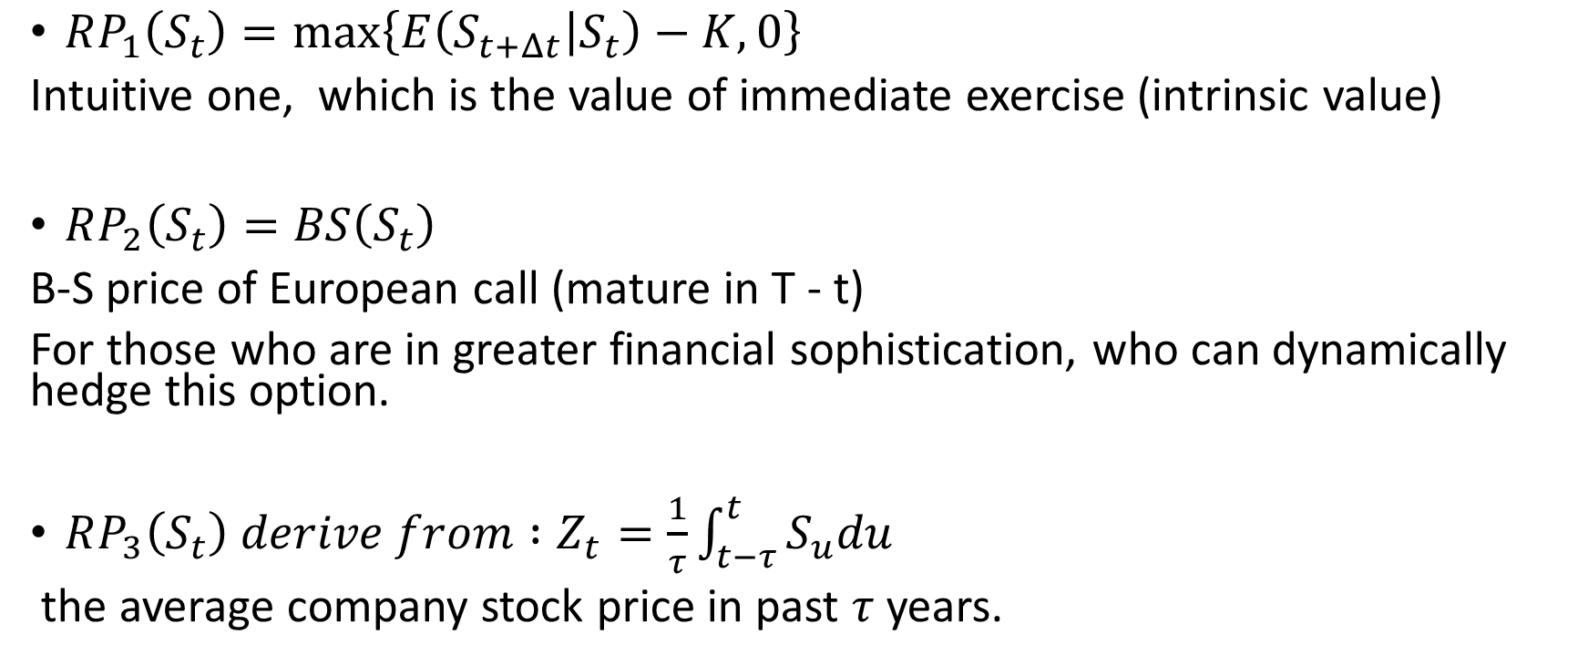

$$Reference point$$
$RP_{1}\left(S_{t}\right)=\max\left\{E\left(S_{t+Δt} | S_{t}\right)−K,0\right\}$
Intuitive one, which is the value of immediate exercise (intrinsic value)
$RP_{2}\left(S_{t}\right)=BS\left(S_{t}\right)$
B-S price of European call (mature in T - t)
For those who are in greater financial sophistication, who can dynamically hedge this option.
$RP_{3}\left(S_{t}\right) derive from :Z_{t}=\frac{1}{τ}\int_{t−τ}^{t}{S_{u}du}$
the average company stock price in past $τ$years.

Slide 14
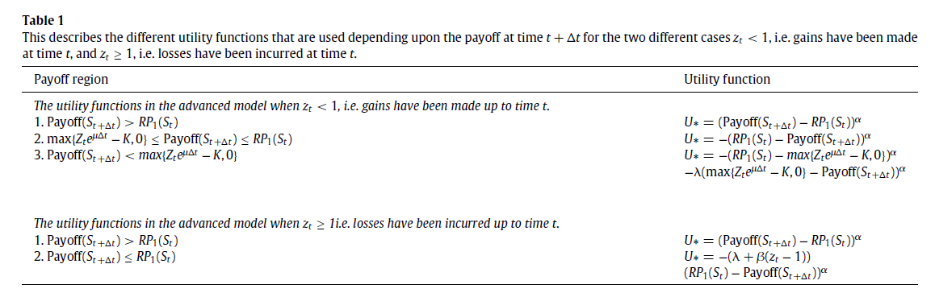

Advanced reference point model (Barberis et al. (2001))
${Let z}_{t} be indicator ≔\frac{Z_{t}}{S_{t}}=\frac{1}{τS_{t}}\int_{t−τ}^{t}{S_{u}du}$

Slide 15
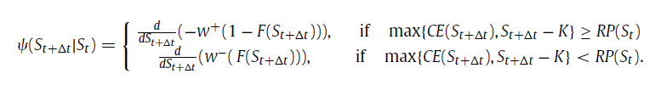
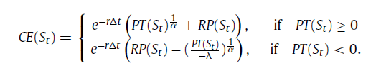

$Ψ is the desicion weight, derived from w^{+},w^{−}$

Slide 16
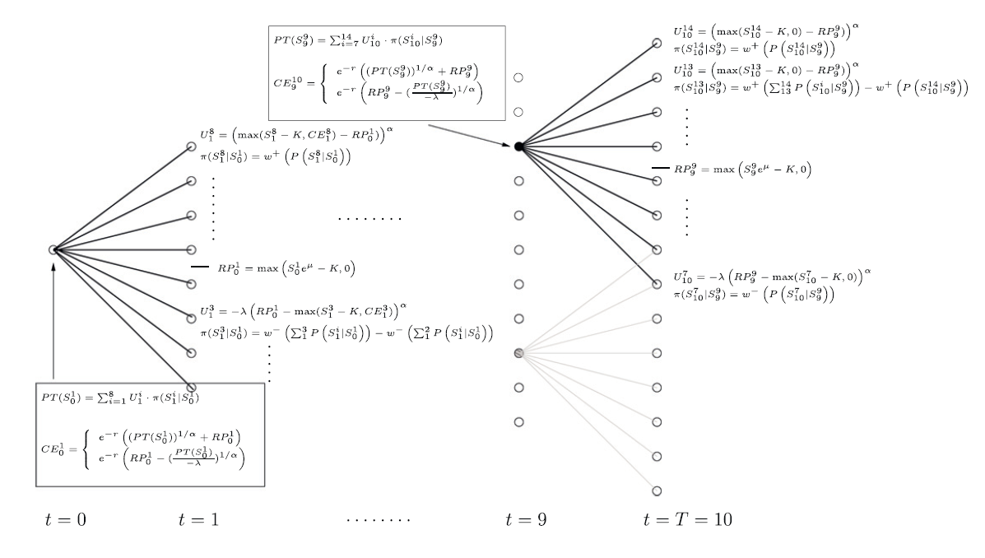
Method – Finite difference

Slide 17
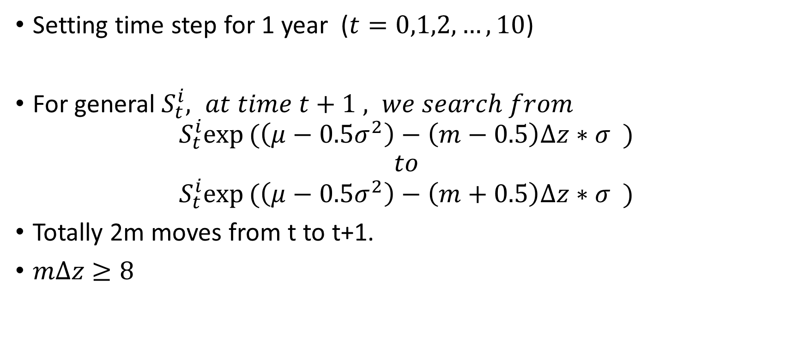
Setting time step for 1 year ($t=0,1,2,…,10$)
For general $S_{t}^{i}, at time t+1 , we search from$
$$S_{t}^{i}exp(\left(μ−0.5σ^{2}\right)−\left(m−0.5\right)Δz∗σ )$$
$$to$$
$$S_{t}^{i}exp(\left(μ−0.5σ^{2}\right)−\left(m+0.5\right)Δz∗σ )$$
Totally 2m moves from t to t+1.
$mΔz≥8$

Slide 18



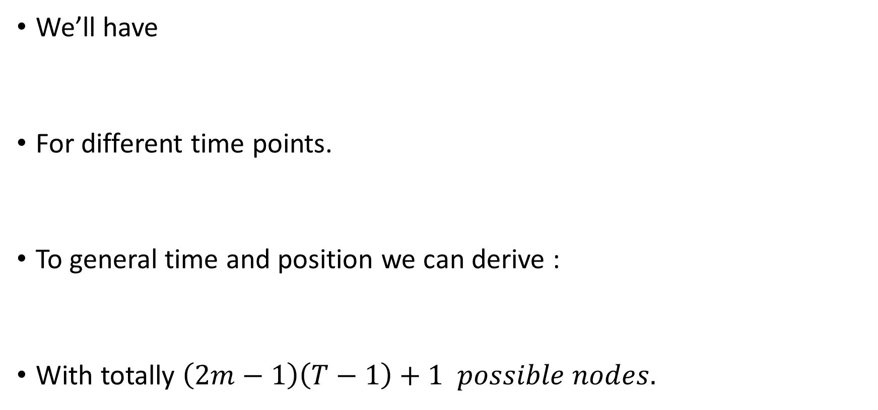
We’ll have
For different time points.
To general time and position we can derive :
With totally $\left(2m−1\right)\left(T−1\right)+1 possible nodes.$

Slide 19
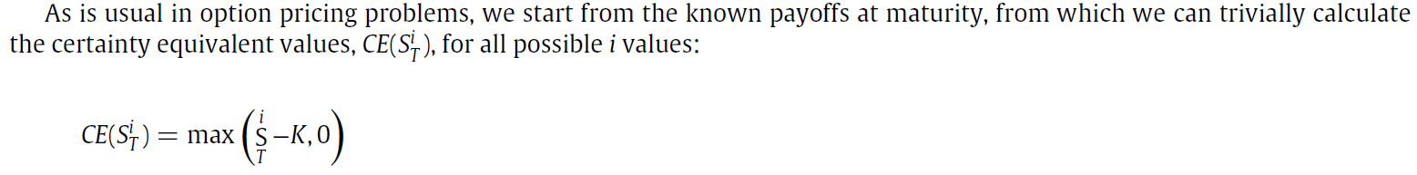
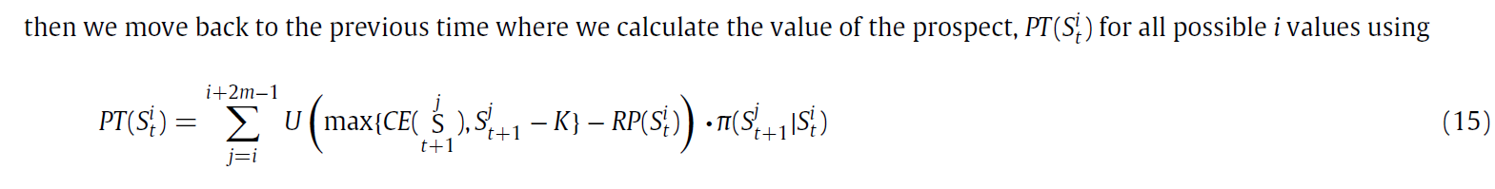
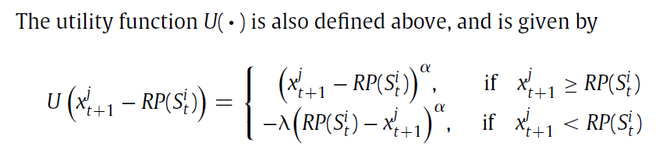
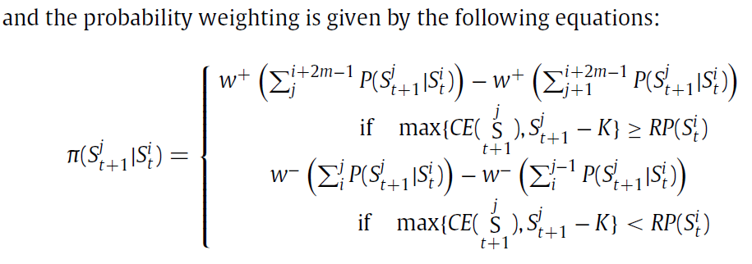

Slide 20
Method – Finite difference

Slide 21

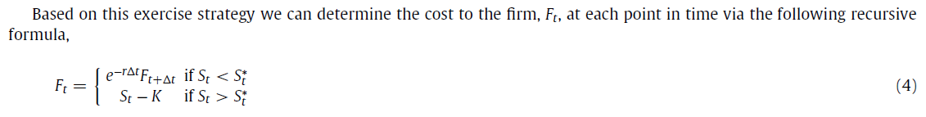

Firm cost of ESO
Firm can hedge the cost of offering option, pricing under risk-neutral.
$Define exercise boundary S_{t}^{∗} satisfying :$
$$STOCK price when \left[value of hold\right]=\left[value of exercise\right]$$

Slide 22

Expected Utility (terminal wealth)
$V\left(W_{T}\right)=\max{E\left[\frac{W_{T}^{1−γ}}{1−γ}\right]}$

Slide 23
Results
ESO to Cash

Slide 24
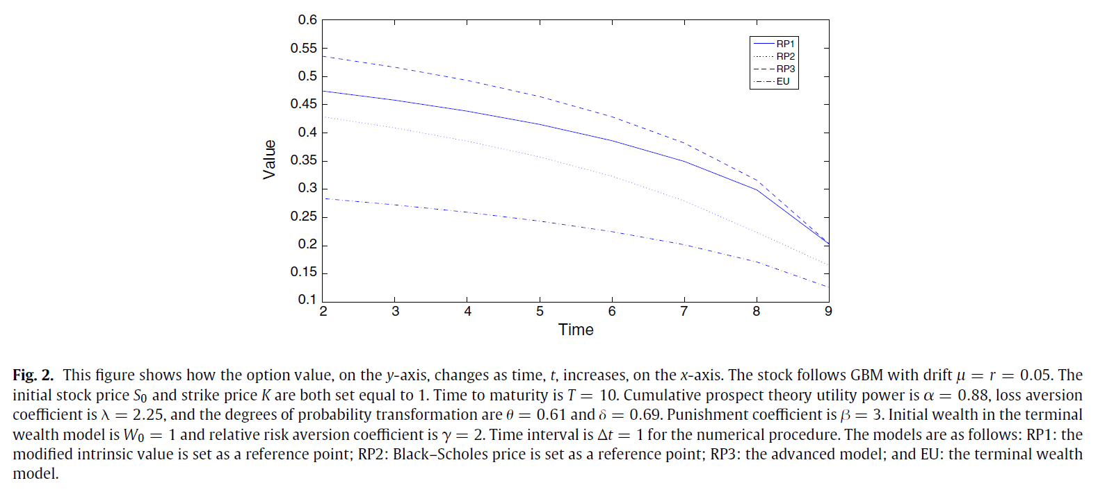
RP3
RP1
RP2
EU

Slide 25
With time to maturity varying from 1 year to 9 years (table2)
(10 year maturity can be observed in Table 3).

Slide 26
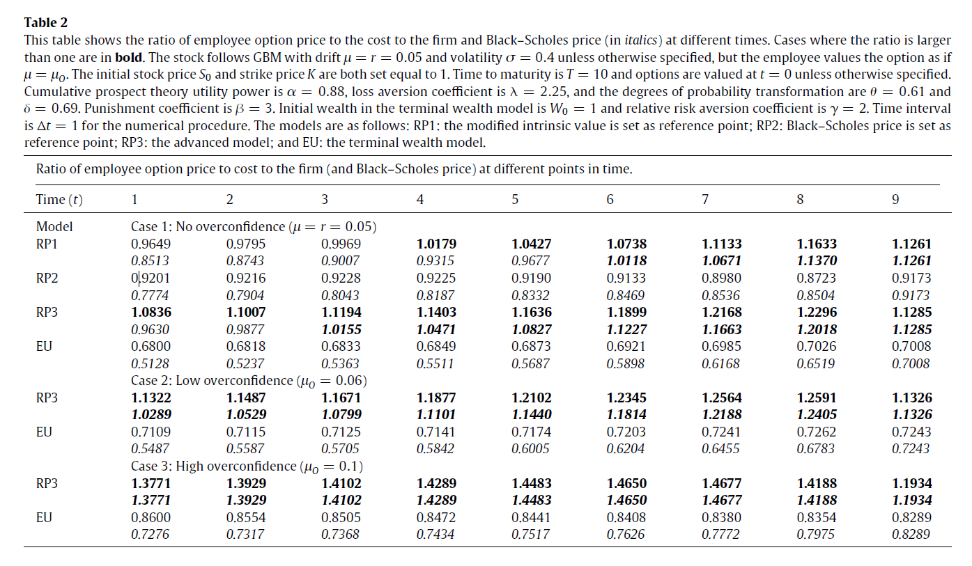

Slide 27
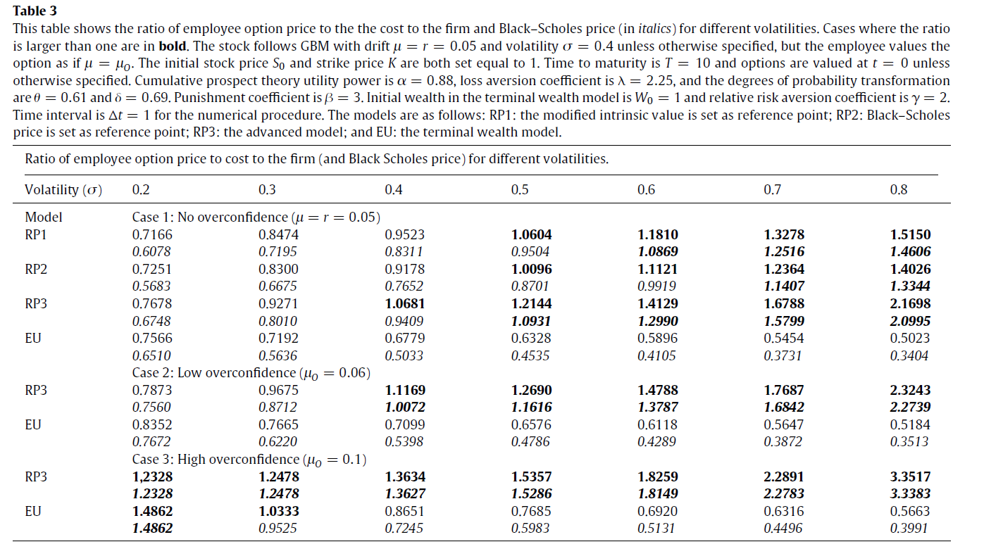

Slide 28
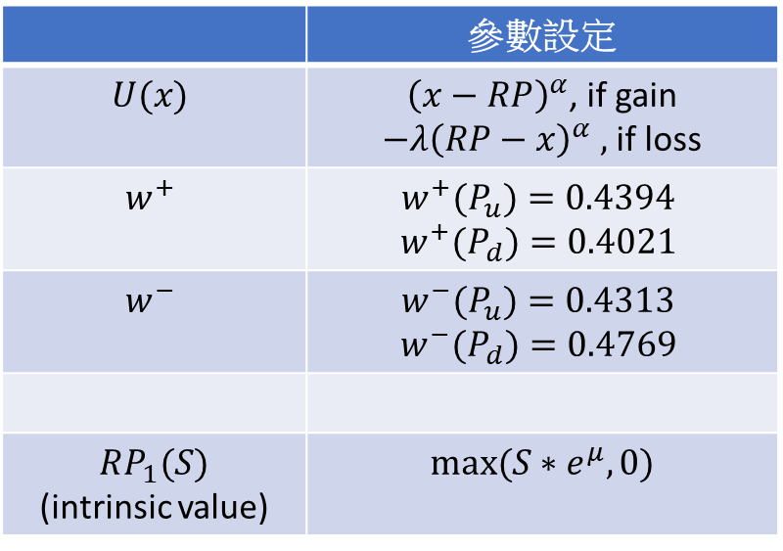
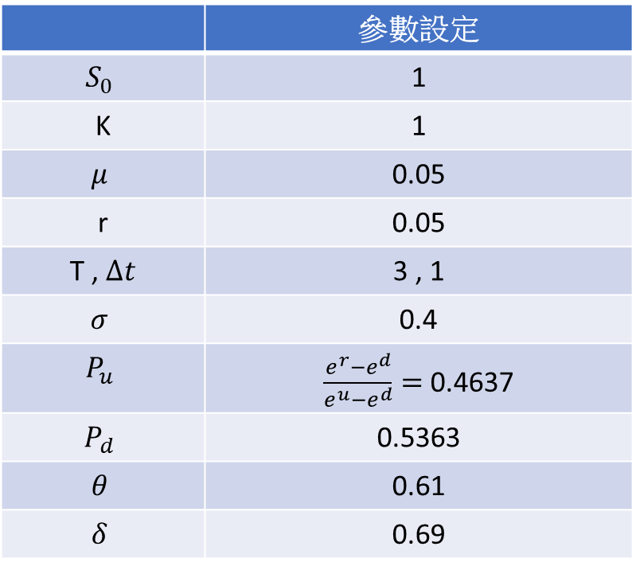
 | 參數設定
$$S_{0}$$ | 1
K | 1
$$μ$$ | 0.05
r | 0.05
T , $Δt$ | 3 , 1
$$σ$$ | 0.4
$$P_{u}$$ | $\frac{e^{r}−e^{d}}{e^{u}−e^{d}}=$ 0.4637
$$P_{d}$$ | 0.5363
$$θ$$ | 0.61
$$δ$$ | 0.69
 | 參數設定
$$U(x)$$ | ${\left(x−RP\right)}^{α}$, if gain $−λ{\left(RP−x\right)}^{α} ,$if loss
$$w^{+}$$ | $${w^{+}(P}_{u})=0.4394$$ $${w^{+}(P}_{d})=0.4021$$
$$w^{−}$$ | $${w^{−}(P}_{u})=0.4313$$ $${w^{−}(P}_{d})=0.4769$$
$RP_{1}(S)$ (intrinsic value) | $$max⁡(S∗e^{μ}, 0)$$

Slide 29
Asset
Value
Continue
Value
Exercise
Value
3.32
2.32
2.23
1.27
1.49
1.23
1.49
0.67
1
1
0.49
0.49
0.34
0.21
0.67
0
0.67
0.09
0
0.45
0
0
0.30
0
0

Slide 30

Asset
Value
PT
Value
Intrinsic
Value ( RP)
3.32
2.32
2.23
1.27
1.49
1.34
1.49
0.67
1
1
0.49
0.57
0.34
0.21
0.67
0.05
0.67
0.09
0
0.45
0
0
0.30
0
0

Slide 31
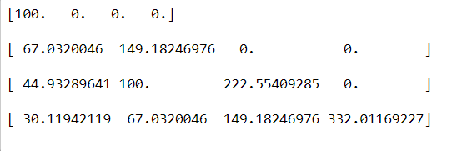
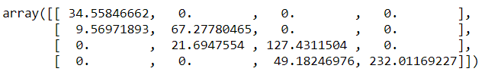

Slide 32
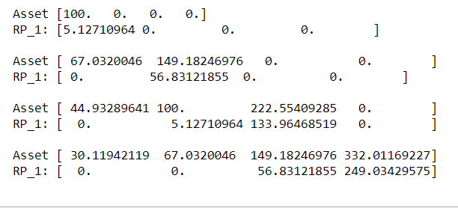
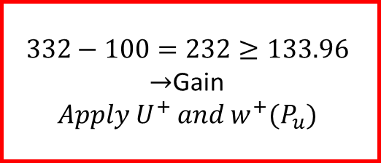
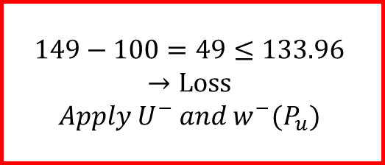
$$149−100=49≤133.96$$
$$→Loss$$
$$Apply U^{−} and w^{−}(P_{u})$$
$$332−100=232≥133.96$$
$→$Gain
$$Apply U^{+} and w^{+}(P_{u})$$

Slide 33
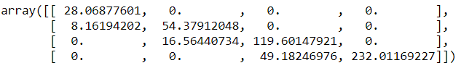
Standard
Binomial tree
Asset value &
Reference point
Prospect theory

Slide 34
Results
ESO to Equity

Slide 35
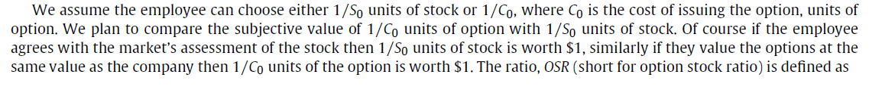
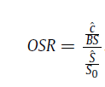
Define OSR (short for option stock ratio)
大於1代表prefer ESO
小於1代表prefer Equity

Slide 36
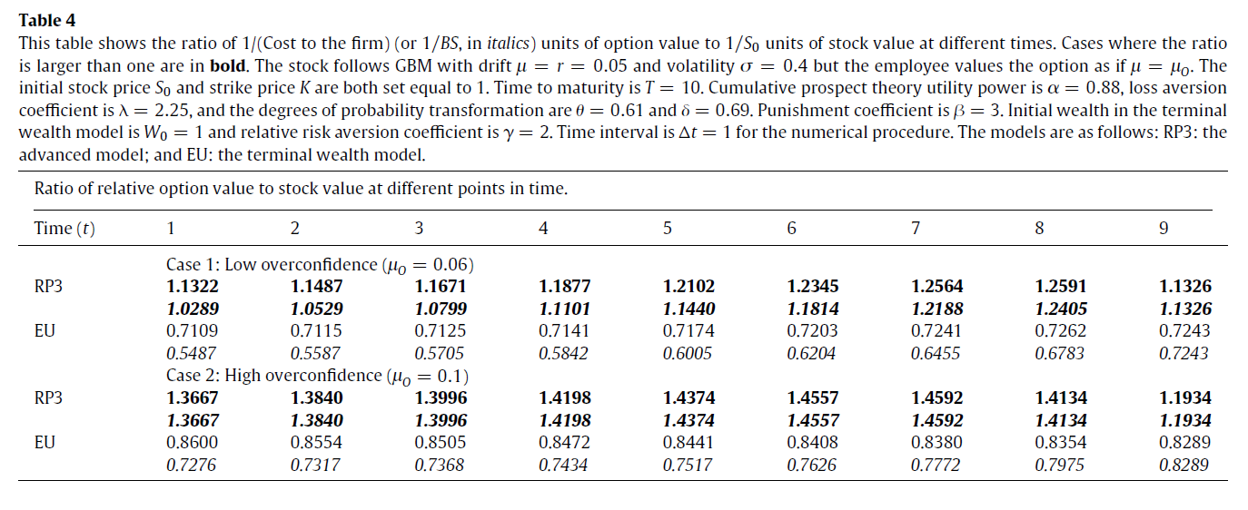

Slide 37
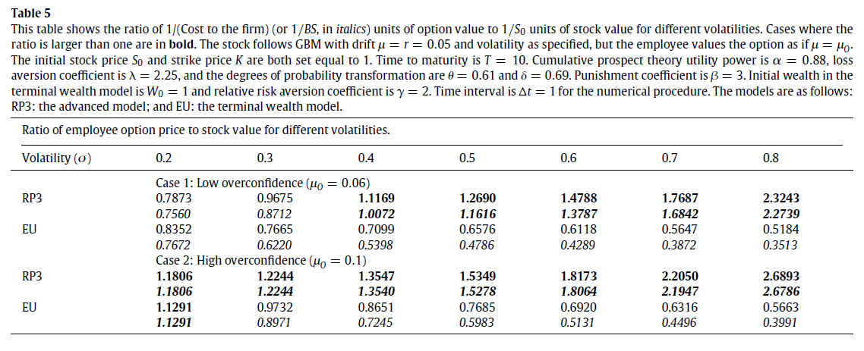

Slide 38
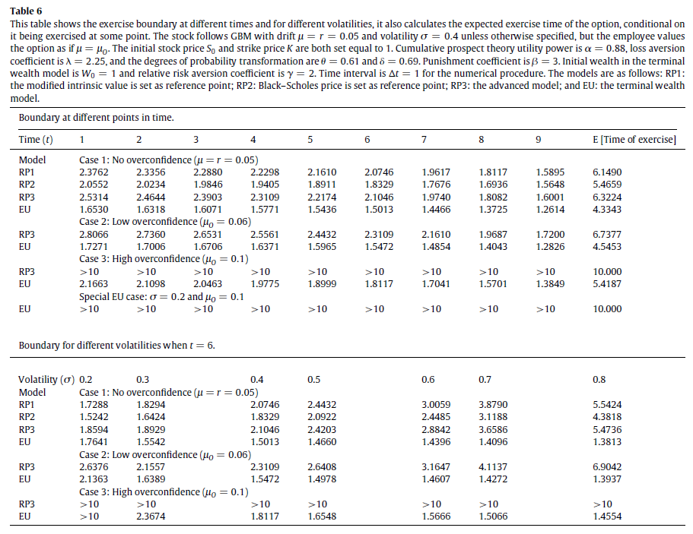
Empirical:
Bettis et al(2005) :
averagely exercise time : 4.55y before

Slide 39
Conclusion
Construct a dynamic, multiperiod prospect model.
Option preferred results (to cash & stock)
(Match empirical) : higher volatility firms issue more option
Loss aversion & Overweight the probability of extreme event.

